Slide 1
10. Greedy Algorithm (1)
PAA 2

Slide 2
Agenda
Greedy Algorithm
Example of greedy algorithm case
Coin Change Problems (review)
Scheduling problem
Fractional Knapsack

Slide 3
A short list of categories
Algorithm types we will consider include:
Simple recursive algorithms
Backtracking algorithms
Divide and conquer algorithms
Dynamic programming algorithms
Greedy algorithms
Branch and bound algorithms
Brute force algorithms
Randomized algorithms

Slide 4
Optimization problems
An optimization problem is one in which you want to find, not just a solution, but the best solution
A “greedy algorithm” sometimes works well for optimization problems
A greedy algorithm works in phases. At each phase:
You take the best you can get right now, without regard for future consequences
You hope that by choosing a local optimum at each step, you will end up at a global optimum
Notes:
2

Slide 5
Example: Counting money
Suppose you want to count out a certain amount of money, using the fewest possible bills and coins
A greedy algorithm would do this would be: At each step, take the largest possible bill or coin that does not overshoot
Example: To make $6.39, you can choose:
a $5 bill
a $1 bill, to make $6
a 25¢ coin, to make $6.25
A 10¢ coin, to make $6.35
four 1¢ coins, to make $6.39
For US money, the greedy algorithm always gives the optimum solution
Notes:
3

Slide 6
A failure of the greedy algorithm
In some (fictional) monetary system, “krons” come in 1 kron, 7 kron, and 10 kron coins
Using a greedy algorithm to count out 15 krons, you would get
A 10 kron piece
Five 1 kron pieces, for a total of 15 krons
This requires six coins
A better solution would be to use two 7 kron pieces and one 1 kron piece
This only requires three coins
The greedy algorithm results in a solution, but not in an optimal solution
Notes:
4

Slide 7
A scheduling problem
You have to run nine jobs, with running times of 3, 5, 6, 10, 11, 14, 15, 18, and 20 minutes
You have three processors on which you can run these jobs
You decide to do the longest-running jobs first, on whatever processor is available
P1
P2
P3
20
10
3
18
11
6
15
14
5
Time to completion: 18 + 11 + 6 = 35 minutes
This solution isn’t bad, but we might be able to do better
Notes:
5

Slide 8
Another approach
What would be the result if you ran the shortest job first?
Again, the running times are 3, 5, 6, 10, 11, 14, 15, 18, and 20 minutes
P1
P2
P3
3
10
15
5
11
18
6
14
20
That wasn’t such a good idea; time to completion is now 6 + 14 + 20 = 40 minutes
Note, however, that the greedy algorithm itself is fast
All we had to do at each stage was pick the minimum or maximum
Notes:
6

Slide 9
An optimum solution
Better solutions do exist:
P1
P2
P3
20
14
18
11
5
15
10
6
3
This solution is clearly optimal (why?)
Clearly, there are other optimal solutions (why?)
How do we find such a solution?
One way: Try all possible assignments of jobs to processors
Unfortunately, this approach can take exponential time
Notes:
7

Slide 10
Applications of the Greedy Algorithm
Find the optimal solutions:
Coin change problem (with “normal” coin denominations)
Minimum Spanning Tree (MST)
Single-source shortest paths
Scheduling problems
Huffman codes
Approximation/heuristics:
TSP
Knapsack problem
Other combinatorial optimization problems

Slide 11
A Generic Greedy Algorithm:
(1) Initialize C to be the set of candidate solutions (2) Initialize a set S = the empty set ∅ (the set is to be the optimal solution we are constructing). (3) While C ≠ ∅ and S is (still) not a solution do (3.1) select x from set C using a greedy strategy (3.2) delete x from C (3.3) if {x} ∪ S is a feasible solution, then S = S ∪ {x} (i.e., add x to set S) (4) if S is a solution then return S (5) else return failure
In general, a greedy algorithm is efficient because it makes a sequence of (local) decisions and never backtracks. The solution is not always optimal, however.

Slide 12
Scheduling Problem

Slide 13
Scheduling Problem
Given set of n proposed activities S = {a₁, a₂, …, a_{n}}
Each activity a_{i} has a start time s_{i} and a finish time f_{i}, where 0 ≤ s_{i} ≤ f_{i} ≤ ∞.
Activity a_{i} and a_{j} is compatible if the intervals [s_{i}, f_{i}) and [s_{j}, f_{j}) do not overlap.
Goals: find maximum-size subset of mutually compatible activities.
Assume that all activites are sorted according to the finish time. f₁ ≤ f₂ ≤ … ≤ f_{n}

Slide 14
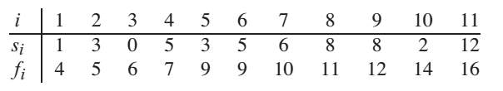
Example

Slide 15
Solutions
Use Dynamic Programming (how?)
Use Greedy Algorithm

Slide 16
Possible Criteria for Defining “Best”
Optimal
Greedy Criterion:
The Shortest Event
Motivation:
Does not book the room for a long period of time.
Schedule first
Optimal
Counter Example

Slide 17
Possible Criteria for Defining “Best”
Optimal
Greedy Criterion:
The Earliest Starting Time
Motivation:
Gets room in use as early as possible
Schedule first
Optimal
Counter Example

Slide 18
Possible Criteria for Defining “Best”
Optimal
Greedy Criterion:
Conflicting with the Fewest Other Events
Motivation:
Leaves many that can still be scheduled.
Schedule first
Optimal
Counter Example

Slide 19
Possible Criteria for Defining “Best”
Greedy Criterion:
Earliest Finishing Time
Motivation:
Schedule the event that will free up your room for someone else as soon as possible.

Slide 20
Greedy Solution
Recursive
Iterative

Slide 21
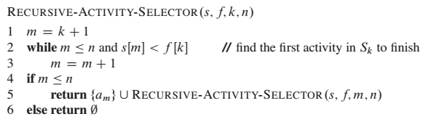
Recursive Greedy Solutions

Slide 22
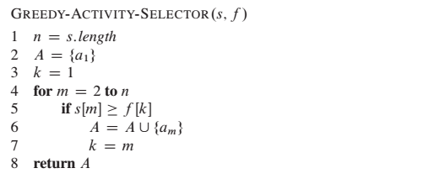
Iterative Greedy Solution

Slide 23
Iterative Greedy Solution
SPOJ - BUSYMAN
Yang diminta:
Jumlah aktivitas

Slide 24
Homework
SPOJ – BUSYMAN
Do the following:
Write down the algorithm: recursive & iterative
Implements into C/C++ programs
Screenshot the output on your computer
Submit to SPOJ by using your own account
Screenshot the verdict → 2 programs
Hard copy

Slide 25
Job Sequencing with Deadlines
Given n jobs. Associated with job I is an integer deadline D_{i}≥0. For any job I the profit P_{i} is earned if the job is completed by its deadline. To complete a job, one has to process the job on a machine for one unit of time.
A feasible solution is a subset J of jobs such that each job in the subset can be completed by its deadline. We want to maximize the

Slide 26
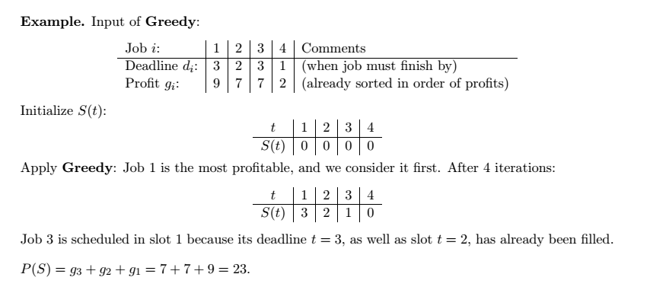
Example: Job Sequencing

Slide 27
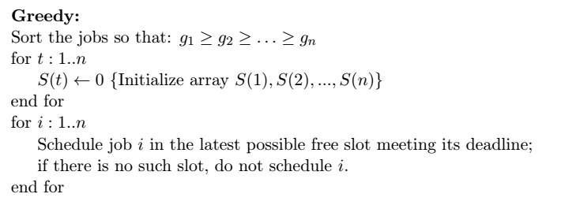
Greedy Solutions

Slide 28
// d: deadline
// profit: profit
// t: timeline
// We assume that the jobs already sorted by its profit (descending order)
Job-sequencing()
total = 0
for i = 1 to n
k = d[i]
while t[k] == 1 and k > 0
k = k – 1
if k!= 0
t[k] = 1
total = total + profit[i]
else
continue

Slide 29
Homework for May 2nd 2017
Continue to implement job sequencing algorithm in C/C++ from:
Your pseudocode
Your friend’s pseudocode
Please give evaluation about the correctness of your and your friend’s algorithm
Please collect the hardcopy → 2 pseudocodes, 2 implementations, 1 evaluation

Slide 30
Example: Job Sequencing
Tasks | Deadlines | Profit
T1 | 7 | 15
T2 | 2 | 20
T3 | 5 | 30
T4 | 3 | 18
T5 | 4 | 18
T6 | 5 | 10
T7 | 2 | 23
T8 | 7 | 16
T9 | 3 | 25

Slide 31
Example: Job Sequencing
Tasks | Deadlines | Profit
T3 | 5 | 30
T9 | 3 | 25
T7 | 2 | 23
T2 | 2 | 20
T4 | 3 | 18
T5 | 4 | 18
T8 | 7 | 16
T1 | 7 | 15
T6 | 5 | 10

Slide 32
Example: Job Sequencing
Tasks | Deadlines | Profit
T3 | 5 | 30
T9 | 3 | 25
T7 | 2 | 23
T2 | 2 | 20
T4 | 3 | 18
T5 | 4 | 18
T8 | 7 | 16
T1 | 7 | 15
T6 | 5 | 10

Slide 33
Pseudocode
Define the pseudocode of job sequencing problem

Slide 34
Homework
SPOJ – MSCHED
Do the following:
Explain the greedy choice needed
Write down the algorithm (pseudocode): iterative greedy → also lines about read the input and print the output 2 algorithms
Implements into C/C++ programs → 2 program
Screenshot the output on your computer
Submit to SPOJ by using your own account → 2 source code
Screenshot the verdict → 2 programs
Hard copy → May, 9th 2017

Slide 35
Optimal Storage on Tapes
There are n programs that are to be stored on a computer tape of length L. Associated with each program i is a length L_{i}.
Assume the tape is initially positioned at the front. If the programs are stored in the order I = i₁, i₂, …, i_{n}, the time t_{j} needed to retrieve program i_{j}
t_{j} =

Slide 36
Optimal Storage on Tapes
If all programs are retrieved equally often, then the mean retrieval time (MRT) =
This problem fits the ordering paradigm. Minimizing the MRT is equivalent to minimizing d(I) =

Slide 37
Example
Let n = 3, (L₁,L₂,L₃) = (5,10,3). 6 possible orderings. The optimal is 3,1,2
Ordering I | d(I)
1,2,3 | 5+5+10+5+10+3 = 38
1,3,2 | 5+5+3+5+3+10 = 31
2,1,3 | 10+10+5+10+5+3 = 43
2,3,1 | 10+10+3+10+3+5 = 41
3,1,2 | 3+3+5+3+5+10 = 29
3,2,1 | 3+3+10+3+10+5 = 34
Input
3
5 10 3
Output
3 1 2
29

Slide 38
Knapsack Problem

Slide 39
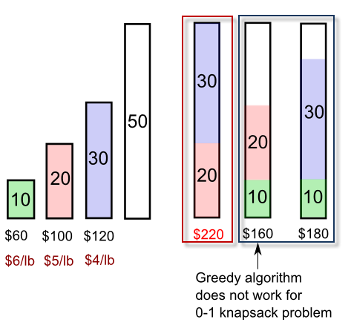
Knapsack Problem
0-1 problem → DP solution

Slide 40
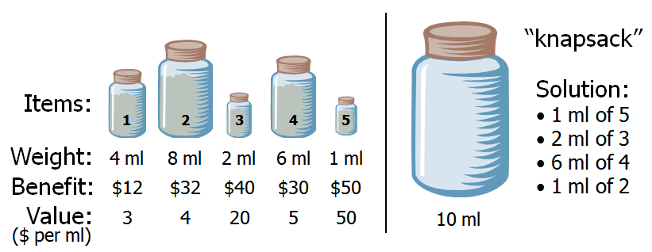
Knapsack Problem
Fractional Problem

Slide 41
The Knapsack Problem:
Given n objects each have a weight w_{i} and a value v_{i} , and given a knapsack of total capacity W. The problem is to pack the knapsack with these objects in order to maximize the total value of those objects packed without exceeding the knapsack’s capacity. More formally, let x_{i} denote the fraction of the object i to be included in the knapsack, 0 ≤ x_{i} ≤ 1, for 1 ≤ i ≤ n. The problem is to find values for the x_{i} such that
Note that we may assume because otherwise, we would choose x_{i} = 1 for each i which would be an obvious optimal solution.

Slide 42
There seem to be 3 obvious greedy strategies:
(Max value) Sort the objects from the highest value to the lowest, then pick them in that order.
(Min weight) Sort the objects from the lowest weight to the highest, then pick them in that order.
(Max value/weight ratio) Sort the objects based on the value to weight ratios, from the highest to the lowest, then select.
Example: Given n = 5 objects and a knapsack capacity W = 100 as in Table I. The three solutions are given in Table II.
select x_{i} value
Max v_{i} 0 0 1 0.5 1 146
Min w_{i} 1 1 1 1 0 156
Max v_{i}/w_{i} 1 1 1 0 0.8 164
w 10 20 30 40 50
v 20 30 66 40 60
v/w 2.0 1.5 2.2 1.0 1.2
Table I
Table II

Slide 43
The Optimal Knapsack Algorithm:
Input: an integer n, positive values w_{i} and v_{i} , for 1 ≤ i ≤ n, and another positive value W.
Output: n values x_{i} such that 0 ≤ x_{i} ≤ 1 and
Algorithm (of time complexity O(n lgn))
(1) Sort the n objects from large to small based on the ratios v_{i}/w_{i} . We assume the arrays w[1..n] and v[1..n] store the respective weights and values after sorting. (2) initialize array x[1..n] to zeros. (3) weight = 0; i = 1 (4) while (i ≤ n and weight < W) do (4.1) if weight + w[i] ≤ W then x[i] = 1 (4.2) else x[i] = (W – weight) / w[i] (4.3) weight = weight + x[i] * w[i] (4.4) i++

Slide 44
Input
4
10 5
40 4
30 6
50 3
Output
105
4 1
2 1
3 0.5

Slide 45
Homework
Implements the Optimum-Storage-on-Tape algorithm into program
Please make a pseudocode for fractional knapsack problem based on input/output needed
Implements the algorithm into C/C++ program
Collect your work at May 23rd → Hardcopy
Small quiz Greedy Algorithm at May 23rd → bring your laptop

